Slide 1

INVENTORY REBALANCING AND DEMAND PLANNING
PRESENTED BY - TEAM 12

Slide 2



OUR TEAM
GARIMA CHOUHAN ​​
GISHA GOPAL
NIKET DALAL​​

Slide 3
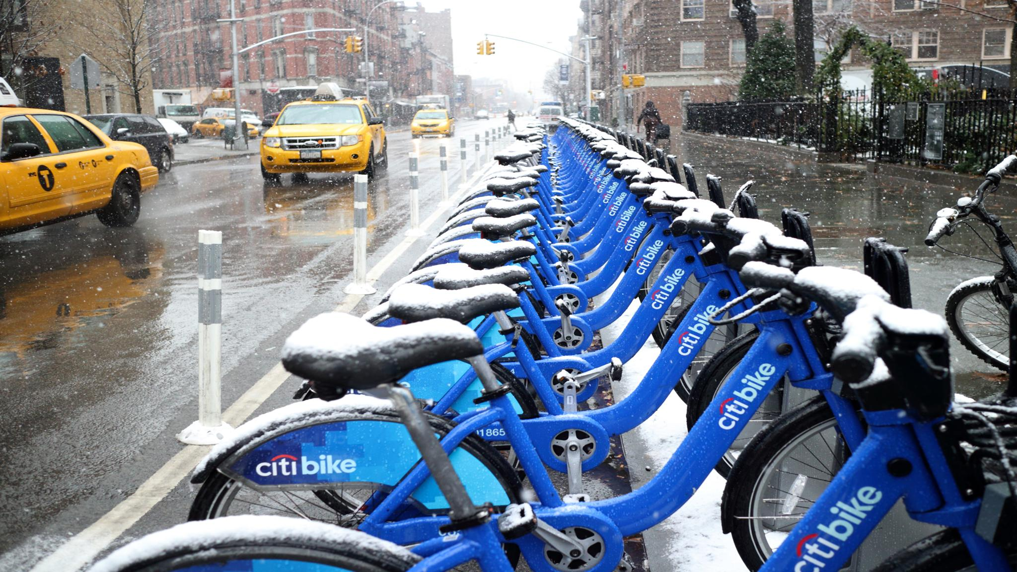
AGENDA
Introduction
Key Problems and challenges facing the company
Data collection and preparation
Full dataset vs. subset of data and Model outputs
Comparing Accuracy measures
How did our Analysis and findings help Management

Slide 4
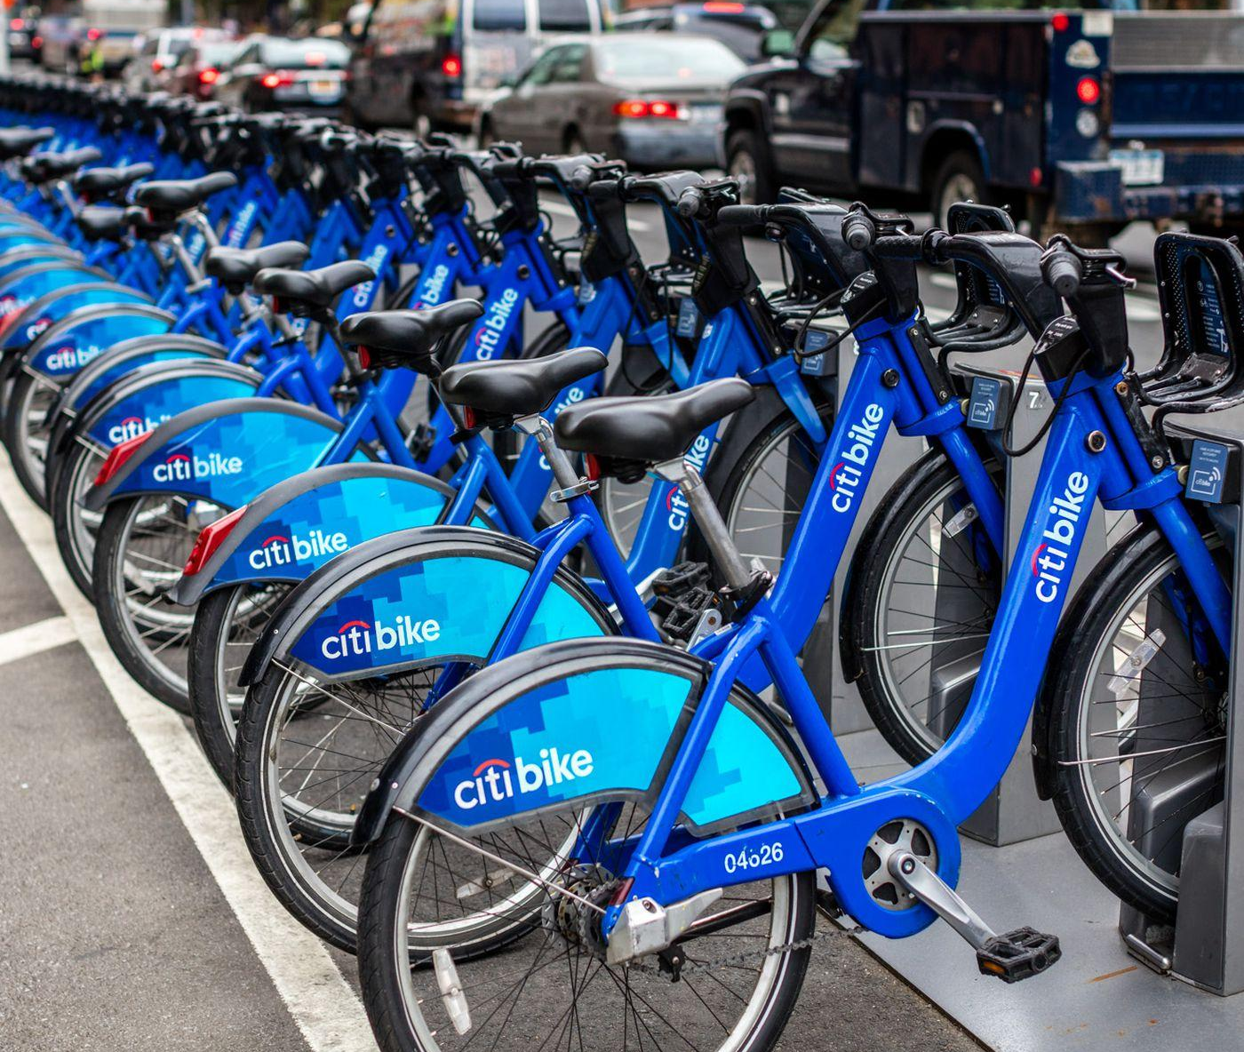
INTRODUCTION
Largest bike sharing system in the US.
Named after lead sponsor Citigroup.
Launched on 27th May 2013
Operates in Bronx, Brooklyn, Manhattan, Queens.
Also operates in JC and Hoboken in NJ (~80 stations)
Acquired by Lyft in Q4 2018.

Slide 5
FACTS AND FIGURES
In 2013, started with 332 Stations and an active bike inventory count of approximately 5000 bikes.
Present day this has grown to 1500+ stations in NYC and an additional 80+ active stations in NJ with an active bike count of approximately 25000+ bikes.
Ridership has grown from 5.8 million in 2013 to over 26 million in 2021.
Annual membership has risen from 52k members to 160k in 2021.
Revenue has grown from $14.3 million in 2013 to $80 million as of Oct 2021.

Slide 6
KEY PROBLEMS FACING THE COMPANY
Inventory and network rebalancing and Demand Planning to overcome empty docks.
Forecasting for accurate demand is extremely challenging as it requires us to consider the effects of intangibles (like weather, traffic pattern, Rider preferences, commuting patterns etc.) on the number of Trips and its duration.
Volatility due to on ground conditions (constructions, Road closures, Pandemic etc.)
Induced Demand in transportation continues to be a challenge.

Slide 7
WHAT ARE WE DOING AND HOW DOES IT MATTER?
Our team will analyze Historic Trip Data for one specific station and run different forecasting models on it.
We will then finalize a Forecasting model based on its accuracy and predict Trip counts for the next six months (2021)
Accurate Forecasts will help Management to accurately plan and predict for future Demand at that station.
It also helps Management make key decisions on factors like Inventory management, Inventory Rebalancing and Daily Operations.
This helps the company mitigate Induced Demand and indirectly help with memberships and revenue increase.

Slide 8
WHAT DATA WE USED
Data Source
Data Wrangling and Preparation​
Citi Bike Trip data is published on their website every month
Dataset is open for public use and is free to download.
Files are segregated between NYC and NJ stations and broken down monthly.
The Dataset grain is on a (single) Trip level.
You can find further details here https://ride.citibikenyc.com/system-data
In order to get past the limitations of the tools we are using we decided to focus on Trip data from one station.
Station of choice [Central Park S. & 6th Ave]
Download Monthly Trip Data and filter for Station ID 2006​.
Aggregate Trips originating from station ID = 2006 to Monthly counts
Repeat this for all the months up to May 2021.
Create .CSV file for consumption into R.

Slide 9
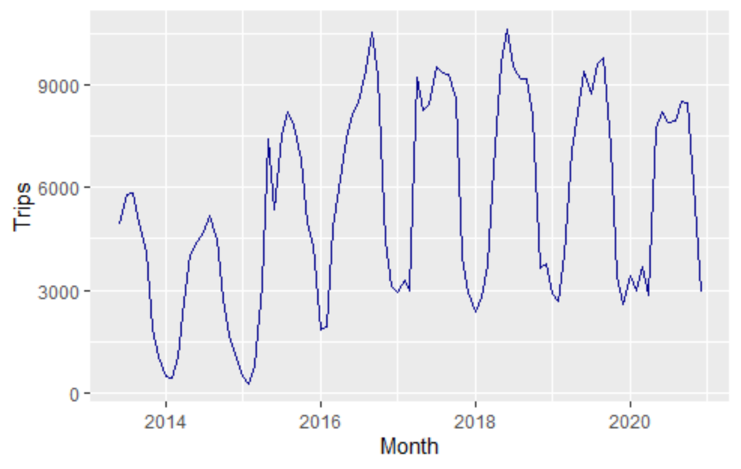
TRIP COUNT FROM START OF TIME
Alongside graph represents Trip Counts from station ID = ‘2006’ which maps to location ‘Central Park S. & 6th Ave.’
Monthly Trip Count data captured from 1st full month of operation [Jun-2013]
As can be seen Trip Counts stabilize from start of 2016.

Slide 10
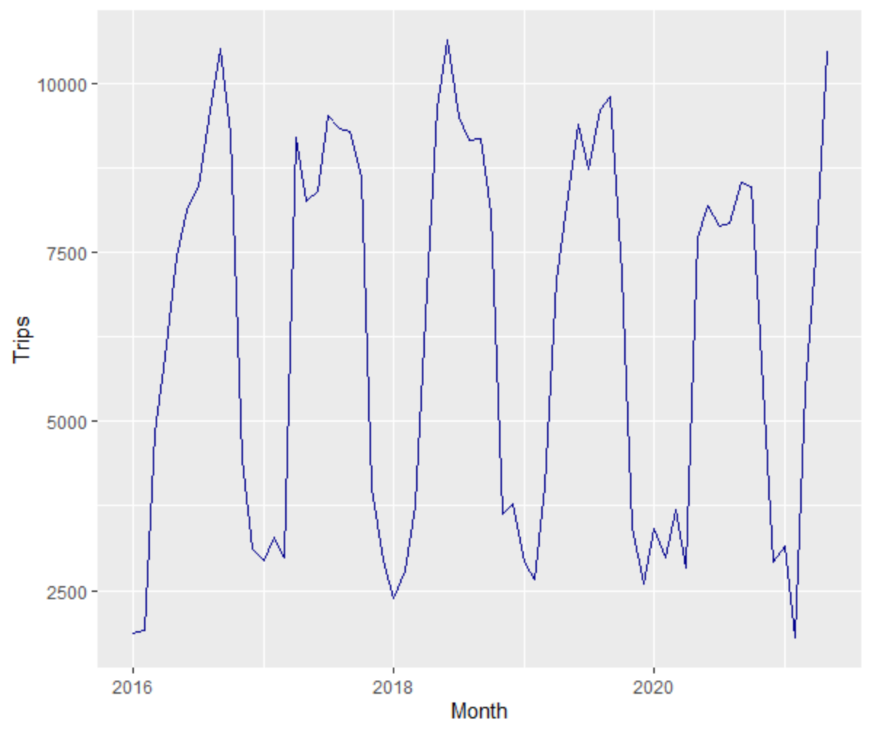
TRIP COUNT [2016] ONWARDS
Alongside graph represents Trip Counts from station ID = ‘2006’ which maps to location ‘Central Park S. & 6th Ave.’
Excluded partial 2013 data along with 2014 and 2015 data to avoid any irregularities in forecasting.
We will use this dataset to create our Time-Series.

Slide 11
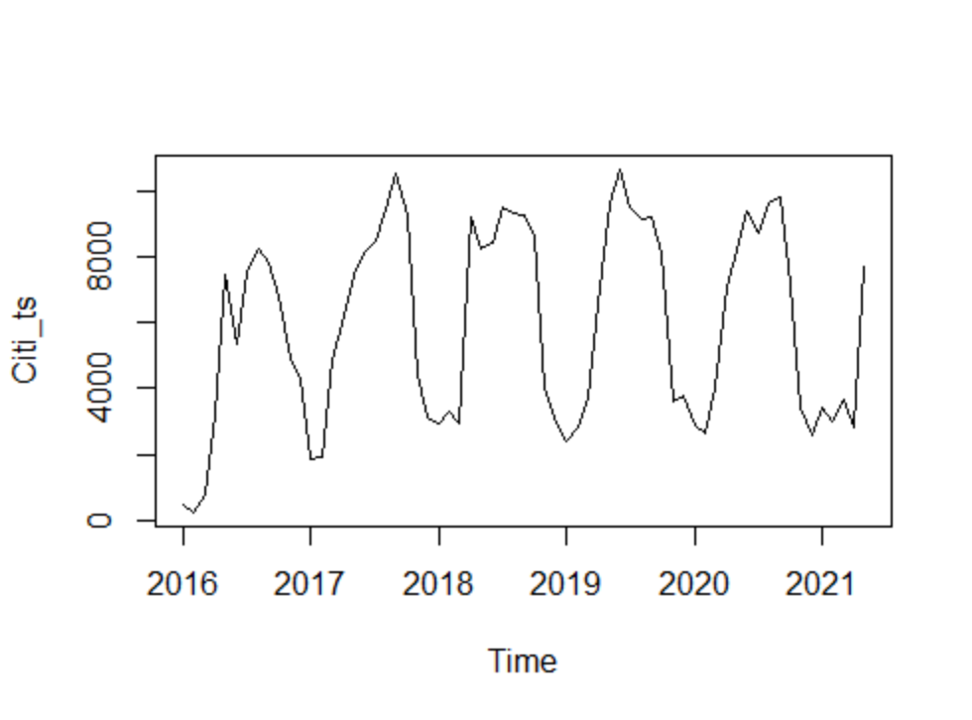
TIME SERIES
We plot the Time Series using data from 2016 until mid 2021.
Our time series shows the following characteristics.
Trend: Slight overall year-over-year growth.
Seasonality: Users make more trips in the summer months and less in the winter.

Slide 12
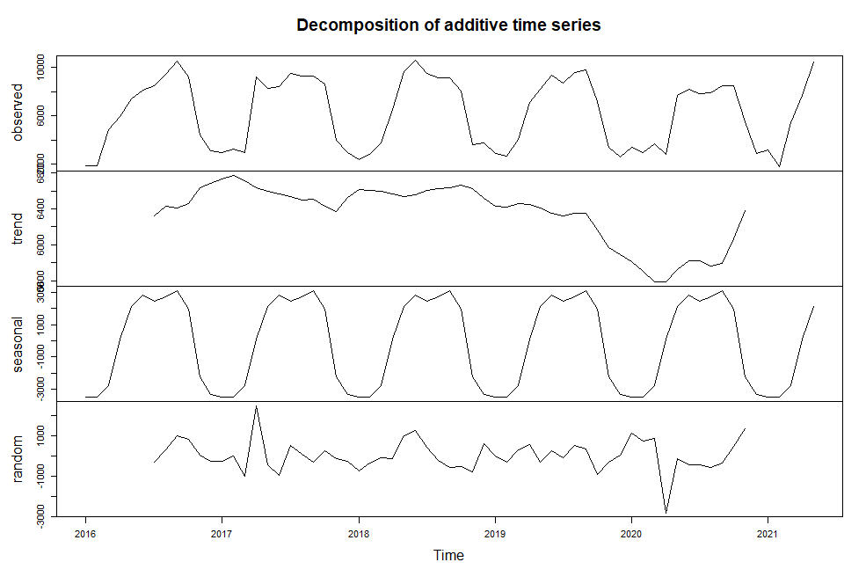
DECOMPOSITION OF TIME SERIES
We plot the Decomposition of our Time Series.
Decomposition breakdown coincides with our observations from the previous slide.
Slight overall year-over-year growth. Drop in around mid 2020 probably due to COVID but picked up quickly after mid 2020.
Clear seasonal pattern detected.

Slide 13
MODELS
Mean
Naive
Seasonal Naive
Random walk
Simple Moving Averages
Exponential Smoothing
Holt Winters
Arima

Slide 14
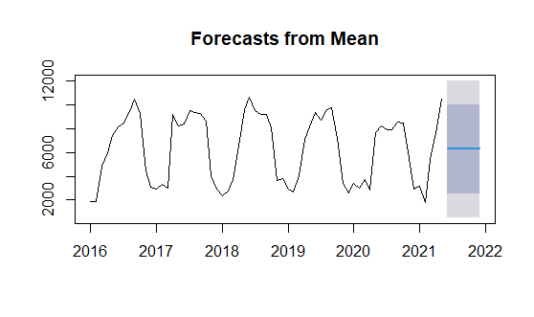
MEAN FORECASTING
ACCURACY VALUES
ME | RMSE | MAE | MPE | MAPE | MASE | ACF1
-2.794e-14 | 2831.015 | 2643.898 | -31.73938 | 61.05208 | 2.498513 | 0.72066

Slide 15
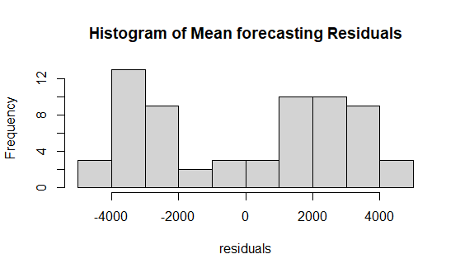
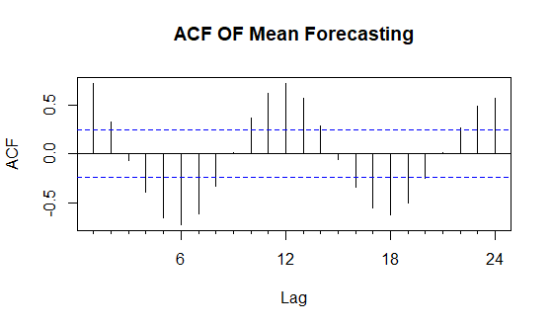
MEAN FORECASTING

Slide 16
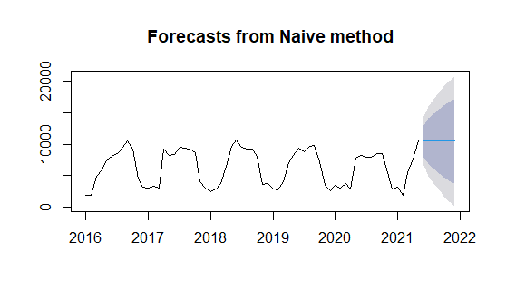
NAIVE FORECASTING
ACCURACY VALUES
ME | RMSE | MAE | MPE | MAPE | MASE | ACF1
134.2656 | 1992.589 | 1399.453 | -4.691763 | 27.14672 | 1.322499 | 0.2720531

Slide 17
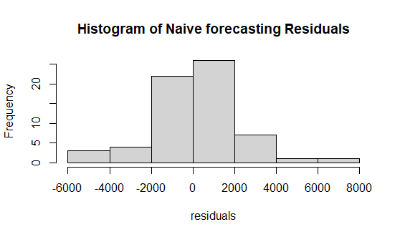
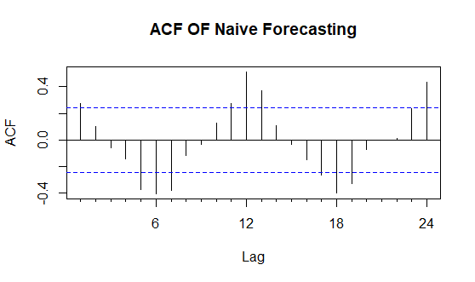
NAIVE FORECASTING

Slide 18
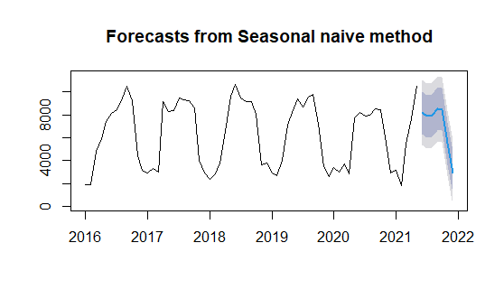
SEASONAL NAIVE FORECASTING
ACCURACY VALUES
ME | RMSE | MAE | MPE | MAPE | MASE | ACF1
49.58491 | 1452.853 | 1058.189 | -2.659102 | 20.42757 | 1 | 0.2370095

Slide 19
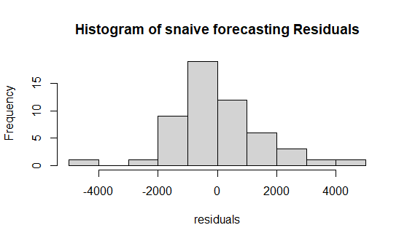
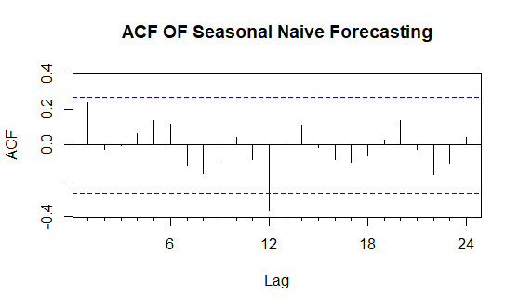
SEASONAL NAIVE FORECASTING

Slide 20
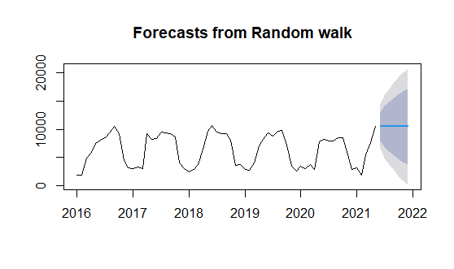
RANDOM WALK FORECASTING
ACCURACY VALUES
ME | RMSE | MAE | MPE | MAPE | MASE | ACF1
134.2656 | 1992.589 | 1399.453 | -4.691763 | 27.14672 | 1.322499 | 0.2720531

Slide 21
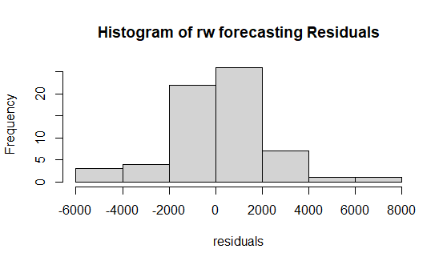
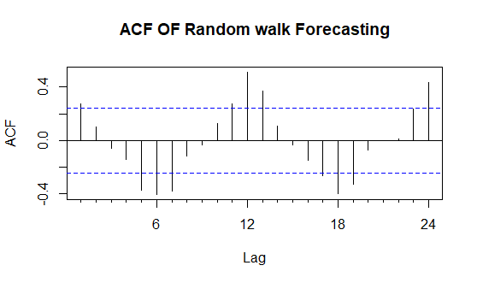
RANDOM WALK FORECASTING

Slide 22
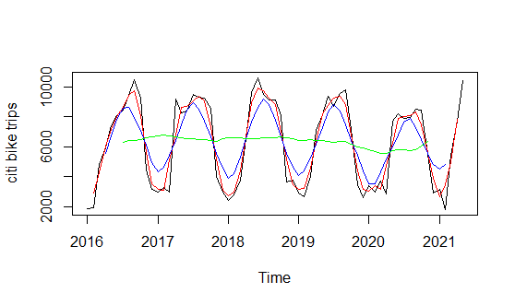
HISTORICAL SIMPLE MOVING AVERAGES
Red 3 order Blue 6 order Green 12 order

Slide 23
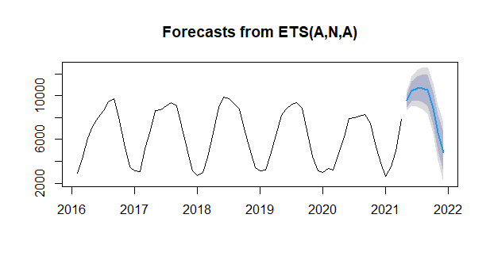
SIMPLE MOVING AVERAGES (ORDER 3)
ACCURACY VALUES
ME | RMSE | MAE | MPE | MAPE | MASE | ACF1
3.67512 | 429.1339 | 318.805 | -0.214658 | 5.981897 | 0.484689 | 0.1088142

Slide 24
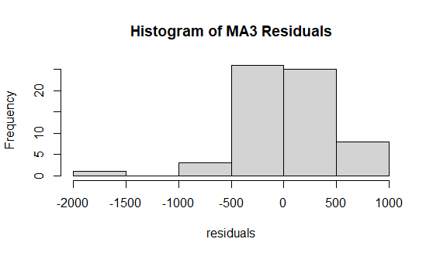
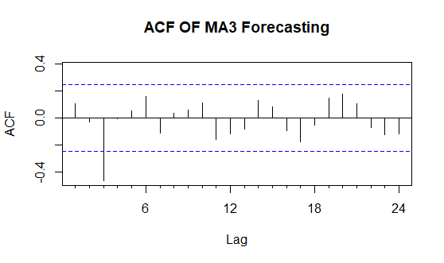
SIMPLE MOVING AVERAGES (ORDER 3)

Slide 25
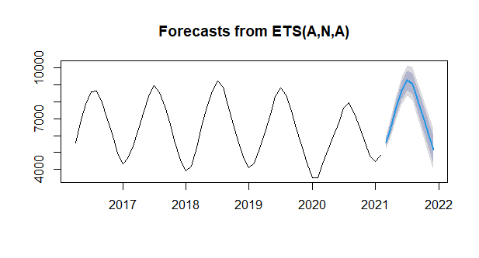
SIMPLE MOVING AVERAGES (ORDER 6)
ACCURACY VALUES
ME | RMSE | MAE | MPE | MAPE | MASE | ACF1
7.185922 | 177.134 | 134.4685 | -0.0677174 | 2.219086 | 0.3065491 | 0.4510698

Slide 26
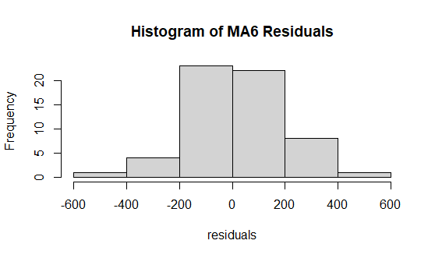
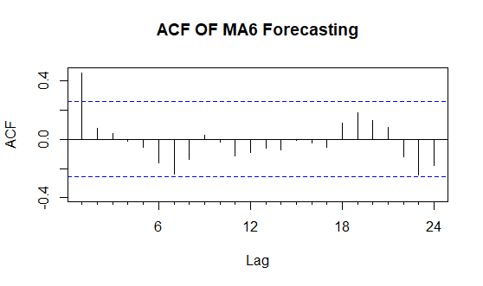
SIMPLE MOVING AVERAGES (ORDER 6)

Slide 27
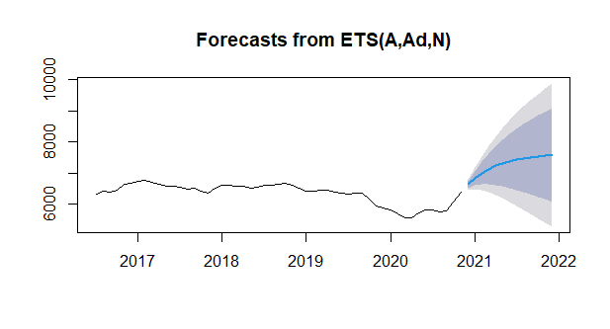
SIMPLE MOVING AVERAGES (ORDER 12)
ACCURACY VALUES
ME | RMSE | MAE | MPE | MAPE | MASE | ACF1
3.895965 | 82.73701 | 61.92499 | -0.027109 | 0.9868236 | 0.2076915 | 0.0107897

Slide 28
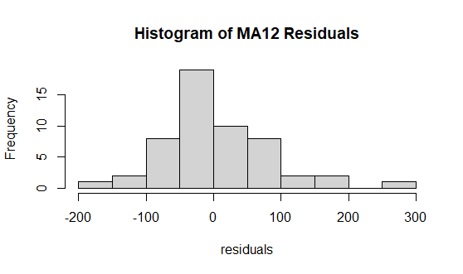
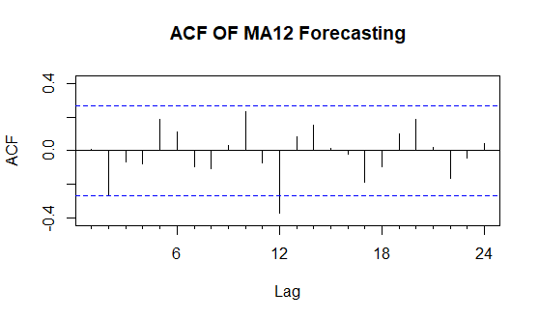
SIMPLE MOVING AVERAGES(ORDER 12)

Slide 29
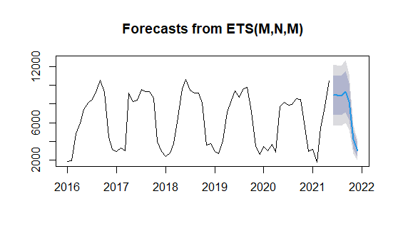
EXPONENTIAL SMOOTHING FORECASTING
ACCURACY VALUES
ME | RMSE | MAE | MPE | MAPE | MASE | ACF1
16.63878 | 921.9082 | 667.9987 | -3.579507 | 13.57865 | 0.6312662 | 0.2100398

Slide 30
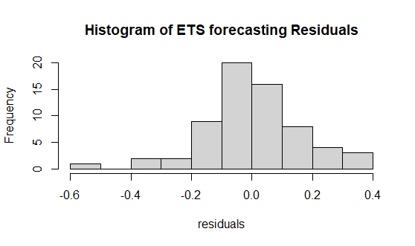
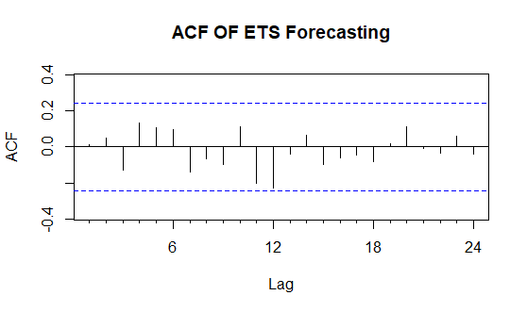
EXPONENTIAL SMOOTHING FORECASTING

Slide 31
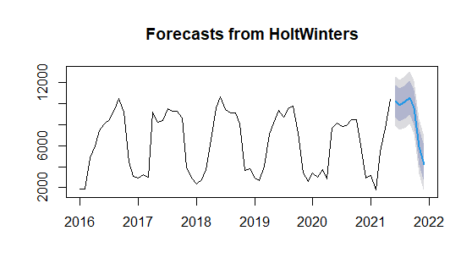
HOLT WINTERS FORECASTING
ACCURACY VALUES
ME | RMSE | MAE | MPE | MAPE | MASE | ACF1
-20.55108 | 1179.395 | 795.9391 | -2.795843 | 15.84126 | 0.7521712 | 0.1013042

Slide 32
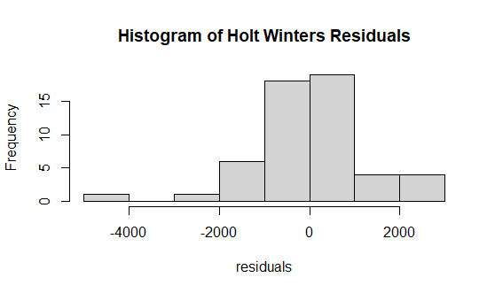
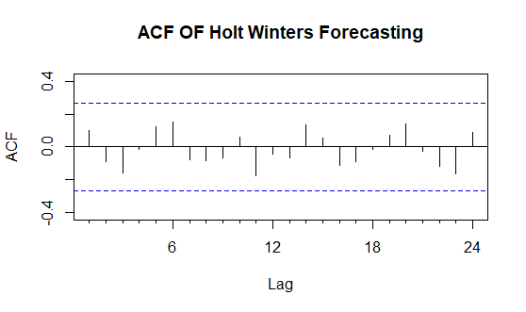
HOLT WINTERS FORECASTING

Slide 33
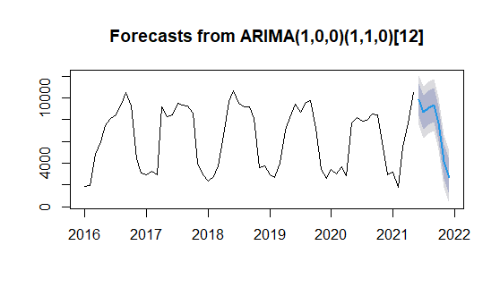
ARIMA
ACCURACY VALUES
ME | RMSE | MAE | MPE | MAPE | MASE | ACF1
9.87972 | 1017.617 | 676.7122 | -2.182681 | 13.46607 | 0.6395005 | -0.014160

Slide 34
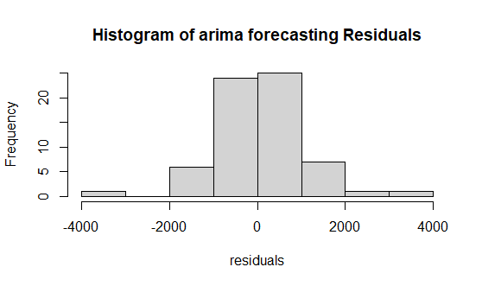
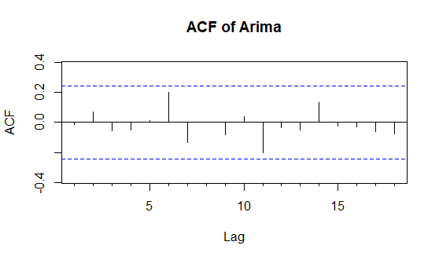
ARIMA

Slide 35
ACCURACIES OF FORECASTING USING MEAN PERCENTAGE ERROR
FORECASTING MODELS | MPE (%)
Simple Moving Averages ( Order 12 ) | -0.0271099
Simple Moving Averages ( Order 6 ) | -0.067717
Simple Moving Averages ( Order 3 ) | -0.214658
ARIMA | -2.182681
Seasonal Naive | -2.659102
Holt Winters | -2.795843
Exponential Smoothing | -3.579507
Naïve | -4.691763
Random Walk | -4.691763
Mean Forecast | -31.73938

Slide 36
DRILLING DOWN TO THE BEST MODEL
Why Moving Averages of order 3 is our best forecasting model
2021 | MA3 | MA12
Jan | 3469.664 | 5912.93
Feb | 3527.736 | 5982.704
Mar | 4850.309 | 6038.524
Apr | 6702.962 | 6083.18
May | 8561.114 | 6118.905
Jun | 9513.069 | 6147.484
Jul | 9737.048 | 6170.348
Aug | 9797.566 | 6188.639
Sep | 9508.67 | 6203.272
Oct | 7785.793 | 6214.978
Nov | 5630.931 | 6224.343
Dec | 3778.935 | 6231.835
It is the best for forecasting commodities with constant demand, where there is a seasonality or slight trend.
Useful for separating out random variations.
More accurate monthly insights lead to better business decisions.
Simplicity of application and interpretation makes it possible to plot several different moving average lines at the same time.
Gives constant forecasts.
Great at smoothing data, form trend lines, and create an easily interpreted visual aid.

Slide 37
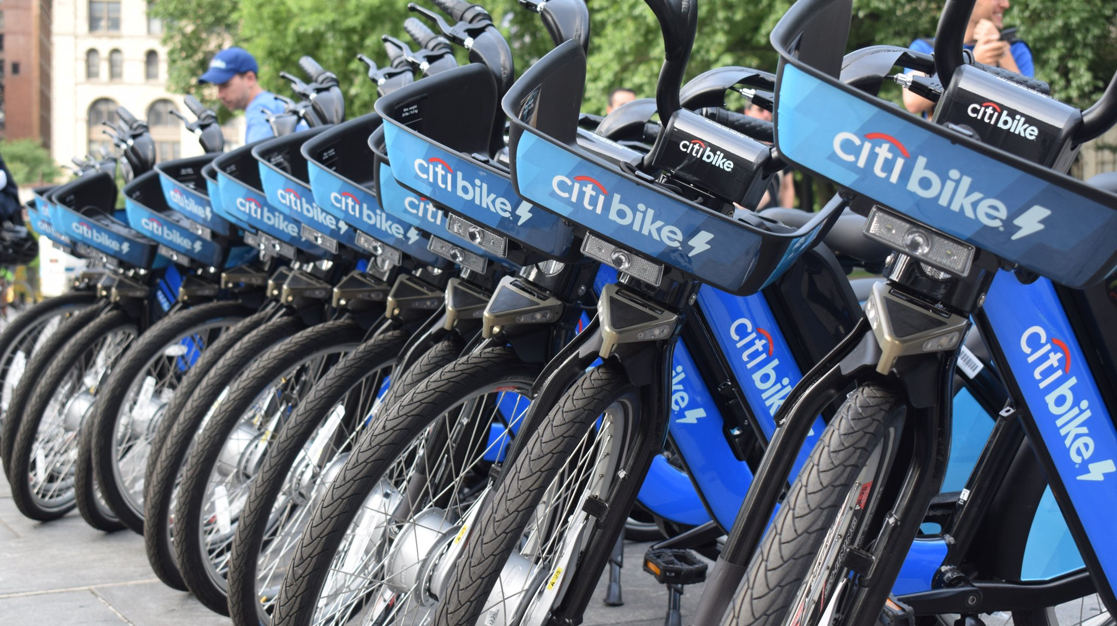
CONCLUSION
For a yearly overview of Citi bike trips usage, simple moving averages forecast of order 12 provides the highest accuracy with a margin of 0.02% error being under-forecasted.
For any monthly, weekly or daily forecasts involving business decisions, moving averages of order 3 stands the best model to predict Citi bike trips data with an accuracy of 99.78%.

Slide 38

THANK YOU

Slide 39
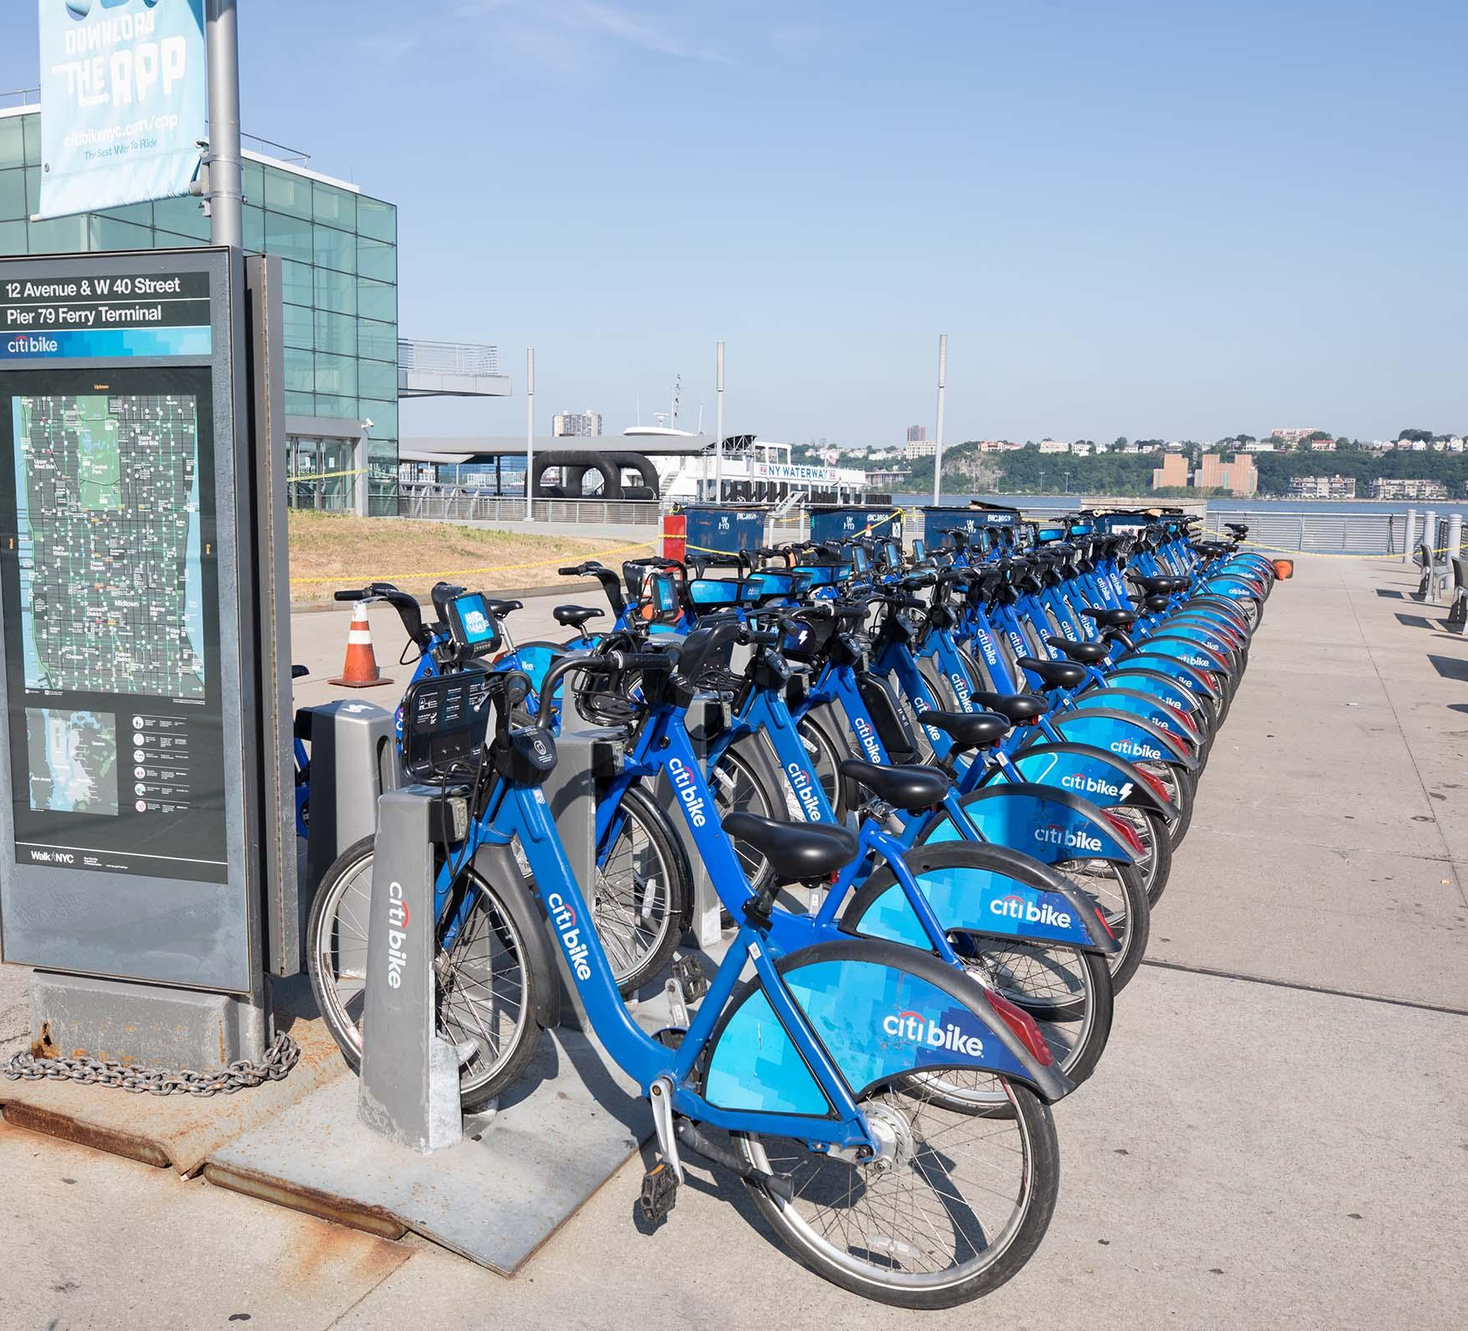
APPENDIX

Slide 40
NEW STATION DISTRIBUTION (MONTH OVER MONTH)

Slide 41
ACTIVE BIKE DISTRIBUTION (MONTH OVER MONTH)

Slide 42
Growth and Expansion Since onset

Slide 43
ANNUAL MEMBERSHIP AND REVENUE
Year | Year Ending Memberships (Annual) | Total Annual Revenue
2013 | 96,125 | $5.8 million
2014 | 88,405 | $8.0 million
2015 | 92,781 | $10.0 million
2016 | 119,681 | $14.1 million
2017 | 136,702 | $16.7 million
2018 | 147,090 | $17.9 million
2019 | 149,740 | $20.5 million
2020 | 167,556 | $19.5 million
2021 | 150,000 (as of Oct) | > $25 million

Slide 44
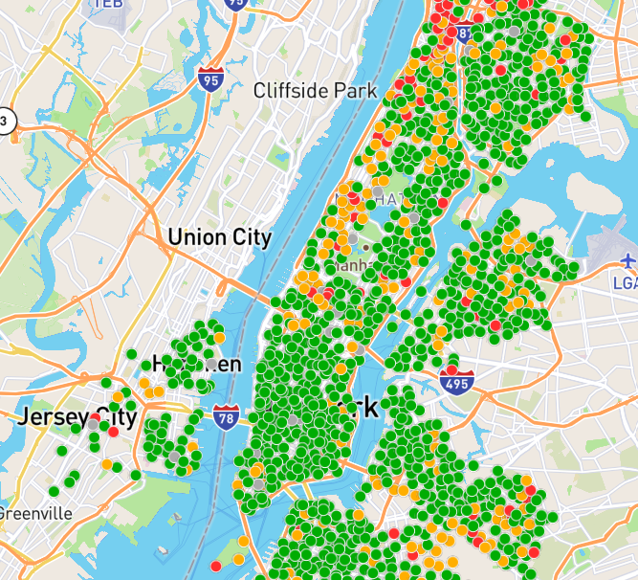
CITI BIKE STATION MAP 1500+ STATIONS IN NYC 80+ STATIONS IN NJ

Slide 45
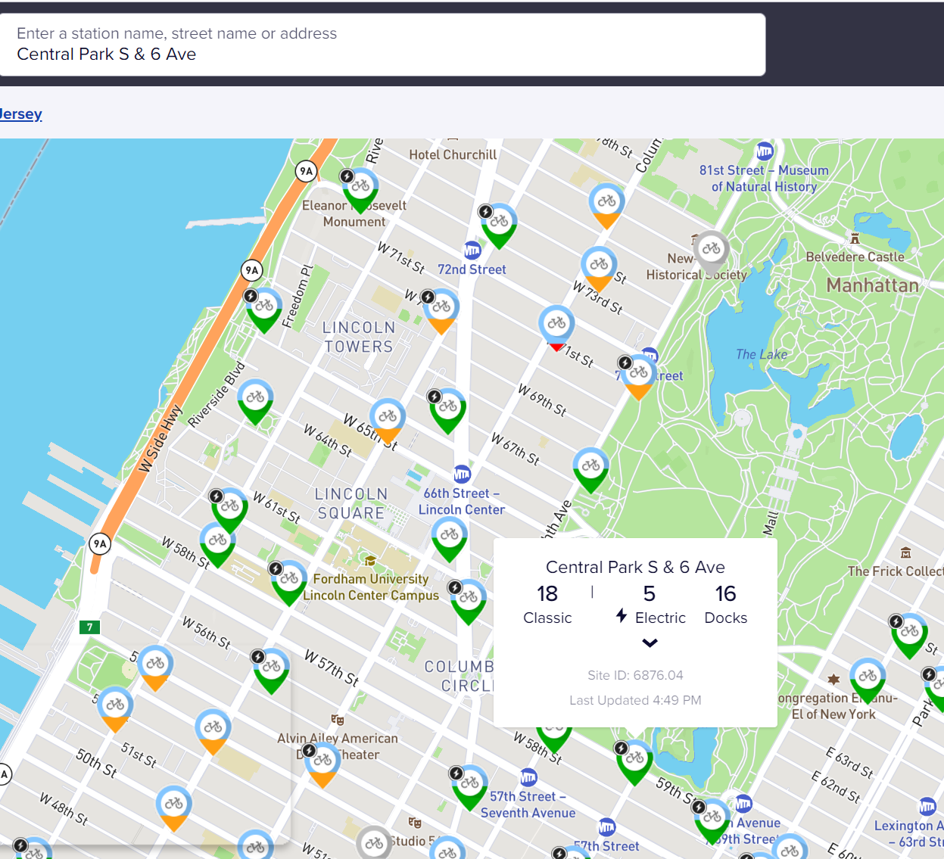
STATION USED FOR OUR ANALYSIS

